Slide 1


Analyzing eCommerce Business Performance with SQL
Created by:
Wika Rabila Putri
rabilaputri@gmail.com
https://www.linkedin.com/in/wika-rabila-putri/
As a fresh graduate in Financial Management, I am eager to dive into the dynamic world of data and business analytics. I am at the start of my journey, focusing on building a strong foundation in SQL, Python, and Data Visualization. My training and virtual internship experiences have equipped me with practical skills, and I am enthusiastic about applying them to create innovative solutions that enhance business decision-making. My passion for continuous learning drives me to contribute meaningfully to any data-driven environment.

Slide 2
Table of Content
Overview
Data Preparation
Annual Customer Activity Growth
Annual Product Category Quality
Annual Payment Type Usage

Slide 3
Overview
"It is undeniable that measuring business performance within a company is crucial for tracking, monitoring, and evaluating the success or failure of various business processes. Therefore, this paper aims to analyze the business performance of an eCommerce company, with a focus on vital metrics such as customer growth, product quality, and payment types."
Click here to view the ERD and Query

Slide 4
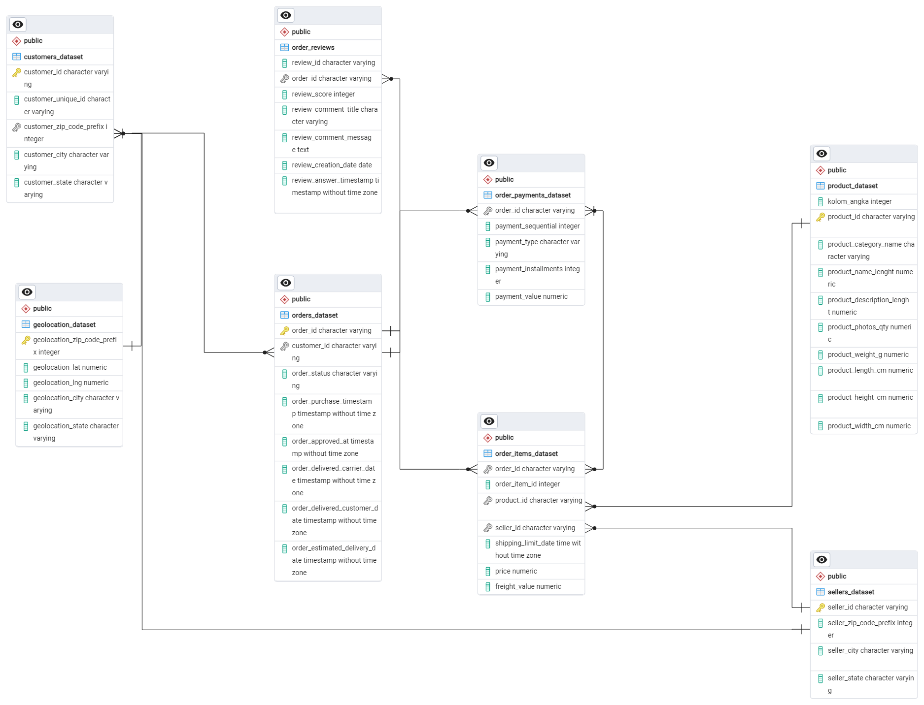
Data Preparation
Create the database first, then create the necessary tables using the CREATE TABLE command.
Import CSV data into each table.
Manually create the ERD (Entity Relationship Diagram), assigning primary keys and foreign keys manually as well, using Tools > ERD Tool.
Click here to view the ERD and Query

Slide 5
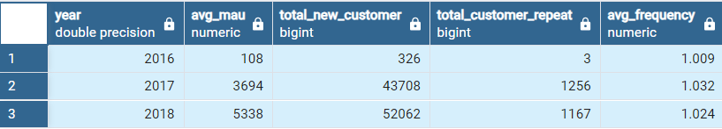
Annual Customer Activity Growth Analysis
The table presents the results of an analysis of annual customer activity growth from 2016 to 2018. It includes key metrics such as the average Monthly Active Users (MAU), the total number of new customers, the total number of repeat customers, and the average frequency of their orders.
Click here to view the Query (TASK 2)

Slide 6
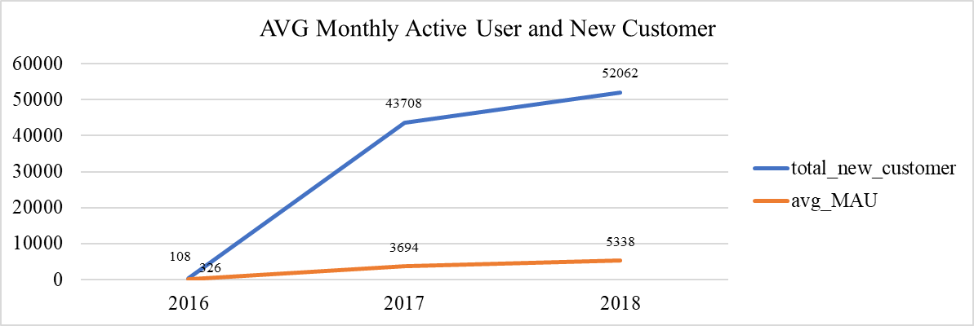
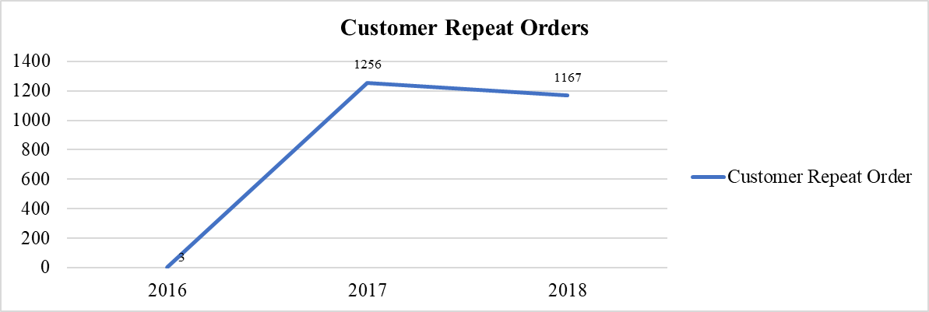
Annual Customer Activity Growth Analysis
In 2016, the average Monthly Active Users (MAU) stood at 108, with 326 new customers joining. By 2017, there was a remarkable surge, with the average MAU skyrocketing to 3,694 and 43,708 new customers signing up. The growth trend continued into 2018, with the average MAU reaching 5,338 and the number of new customers soaring to 52,062. This impressive increase highlights a growing and sustained interest from new customers each year.
The repeat order analysis reveals an intriguing trend. In 2016, there were just 3 customers making repeat purchases. This number surged to 1,256 in 2017, indicating that more customers found value in making repeat purchases. In 2018, the figure slightly declined to 1,167 but remained significantly higher compared to 2016.
Click here to view the Query (TASK 2)

Slide 7
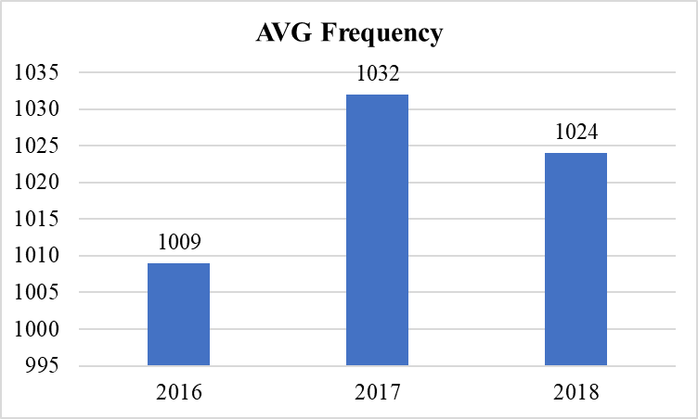
Annual Customer Activity Growth Analysis
The average transaction frequency of customers also shows a positive shift. In 2016, the average transaction frequency was 1.009. This increased to 1.032 in 2017, indicating that customers began transacting more frequently. However, in 2018, there was a slight decline to 1.024. Despite this small drop, the frequency remains higher than in 2016.
Overall, the data from Task 2 demonstrates robust growth in new customer acquisition and activity, despite some fluctuations in transaction frequency and repeat orders. The significant rise in new customers and MAU reflects a growing awareness and acceptance of the service among customers.
Click here to view the Query (TASK 2)

Slide 8
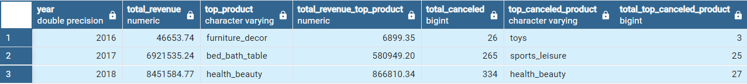
Annual Product Category Quality Analysis
The table presents the results of the product category quality analysis from 2016 to 2018, focusing on total revenue, revenue from top products, and the number of cancellations for top products.
Click here to view the Query (TASK 3)

Slide 9
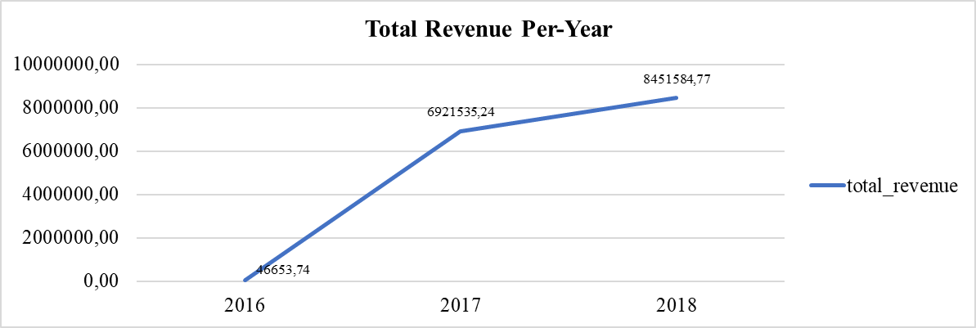
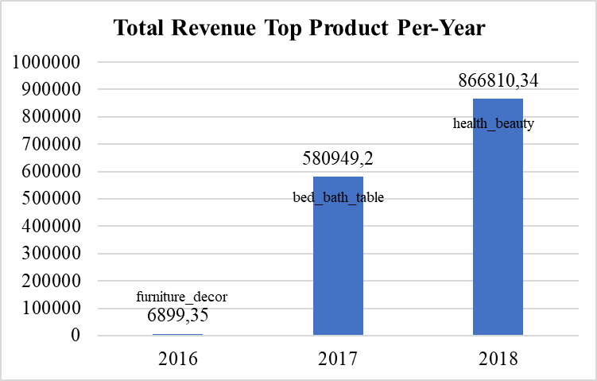
Annual Product Category Quality Analysis
In 2016, the company's total revenue reached 46.653,74. This figure saw a dramatic increase in 2017, rising to 6.921.535,24, indicating remarkable growth. The positive trend continued in 2018, with total revenue climbing further to 8.451.584,77. This significant year-over-year growth reflects a strong increase in business activity and market acceptance of the company's products.
The top revenue-generating products varied each year. In 2016, the "furniture_decor" category was the highest contributor, generating 6.899,35. In 2017, the "bed_bath_table" category emerged as the top product, with revenue of 580.949,20. By 2018, the "health_beauty" category recorded the highest revenue at 866.810,34. This variation highlights changing customer preferences towards different product categories each year.
Click here to view the Query (TASK 3)

Slide 10
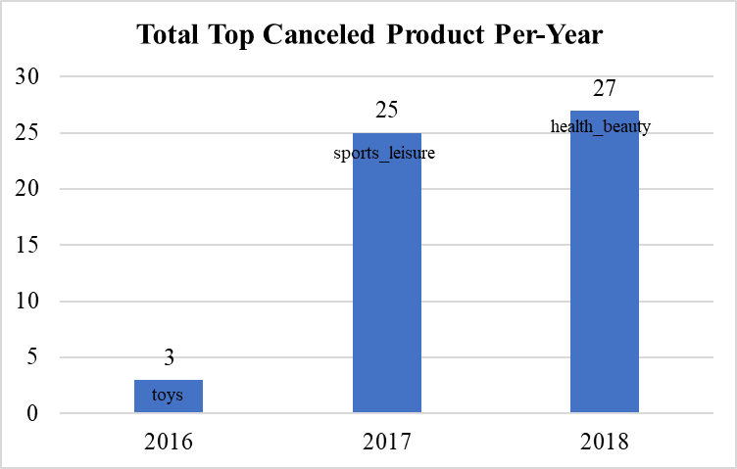
Annual Product Category Quality Analysis
The number of cancellations for top products also varied. In 2016, the "toys" category saw 3 cancellations, while in 2017, the "sports_leisure" category recorded 25 cancellations, the highest in the period. In 2018, the "health_beauty" category experienced 27 cancellations, the highest for that year. Although the number of cancellations increased alongside rising total revenue, this may indicate challenges in maintaining quality and customer satisfaction for popular products.
Overall, Task 3 demonstrates robust growth in company revenue year over year, with varying top product categories. However, the increase in cancellations for top products highlights the need for improvements in quality management and customer satisfaction.
Click here to view the Query (TASK 3)

Slide 11
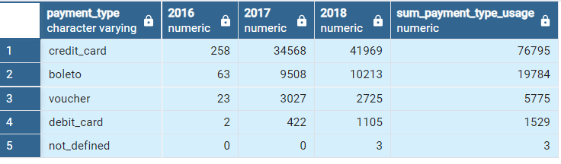
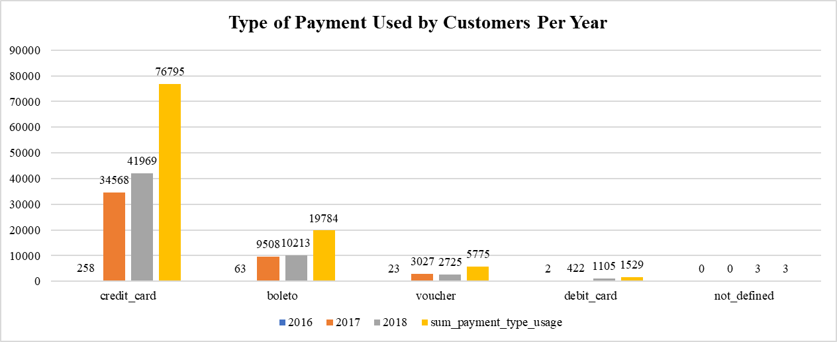
Analysis of Annual Payment Type Usage
The table presents the results of the analysis of various payment methods from 2016 to 2018, including credit card, boleto, voucher, debit card, and undefined payment methods. This data provides insights into customer preferences for payment methods and how these trends have evolved over the analyzed period.
Based on data from 2016 to 2018, credit card emerged as the most dominant payment method, showing a steady increase from 258 transactions in 2016 to 34.568 in 2017, and 41.969 in 2018. The use of boleto also rose, from 63 transactions in 2016 to 9.508 in 2017, and 10.213 in 2018. Voucher transactions started at 23 in 2016, grew to 3.027 in 2017, but slightly declined to 2.725 in 2018. Debit card usage increased consistently from 2 transactions in 2016 to 422 in 2017, and 1.105 in 2018. Undefined payment methods were recorded only in 2018 with 3 transactions. Overall, credit card remains the preferred payment method, with its usage rising each year.
Click here to view the Query (TASK 4)

